Slide 1
A Multi-Agent Q-learning Framework for Optimizing Stock Trading Systems
2018. 02. 26
권도형
LINK-lab

Slide 2
Jae Won Lee, Jangmin O (2002). A Multi-Agent Q-learning Framework for Optimizing Stock Trading Systems. DEXA 2002: 153-162.

Slide 3
abstract
This paper presents a reinforcement learning framework for stock trading systems.
Agents communicate with others sharing training episodes and learned policies, while keeping the overall scheme of conventional Q-learning.
We demonstrate a stock trading system implemented using the proposed framework can significantly outperform the market average and the one implemented by conventional supervised learning algorithm.

Slide 4
Introduction
The objective of reinforcement learning is not the minimization of the sum-of-squares error which is actually the objective of conventional supervised learning but the acquisition of an optimal policy under which the learning agent achieves the maximal average reward from the environment.
This paper proposes a reinforcement learning framework with multiple cooperative agents to integrate prediction criteria with trading policies more effectively.
The agents for buy and sell signals use a matrix named turning-point structure in order to model the long-term dependencies of stock prices.
To utilize intraday price swings, the agents for ordering executions optimize the short-term policies.
Q-learning is adopted for training the agents to get optimal policies.

Slide 5
backgrounds
Reinforcement learning is a computational approach for understanding and automating goal directed learning and decision making.
In the reinforcement learning framework, especially in Markov decision process (MDP), there are an agent and an environment interacting with each other at discrete time steps t.
The agent selects an action from its policy based on the state of the environment.
If certain action is taken by the agent, the environment changes its state responding to action t and also gives rise to a reward.
The objective of the agent is to learn an optimal policy, a mapping from states to actions, that maximizes the expected discounted future reward from state-action pair (s, a), called action-value function Qπ(s, a).

Slide 6
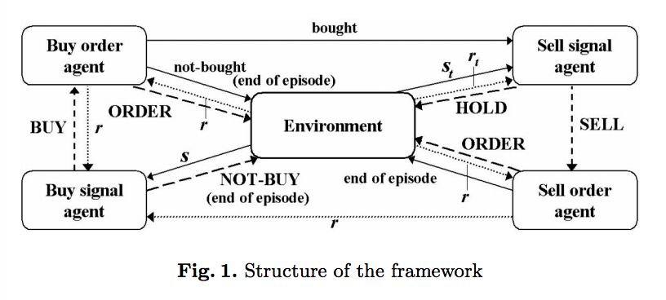
Proposed Framework and Algorithm
- Overall Structure
a multi-agent framework
This framework aims to maximize the profits of investments by considering not only global trends of stock prices but also intraday price movements of stocks.

Slide 7
Proposed Framework and Algorithm
- Overall Structure
Each agent has its own goal to achieve and interacts with others to share episodes in the learning process:
Buy signal agent performs prediction by estimating the long-term and short-term information of the states of stocks to produce buy signals.
Buy order agent determines prices for bids by estimating the short-term information of the states of stocks. A bid is an order to buy at a given price.
Sell signal agent performs prediction by estimating the long-term and short-term information of the states of stocks and the current profits, to produce sell signals.
Sell order agent determines the prices for offers by estimating the short-term information of the states of stocks. An offer is an order to sell at a given price.

Slide 8
Proposed Framework and Algorithm
- States, Actions, and Rewards
One of the most important keys to achieve reasonable performance in machine learning is the representation of the input space.
Specially reinforcement learning is an art of the design of state, action and reward.

Slide 9
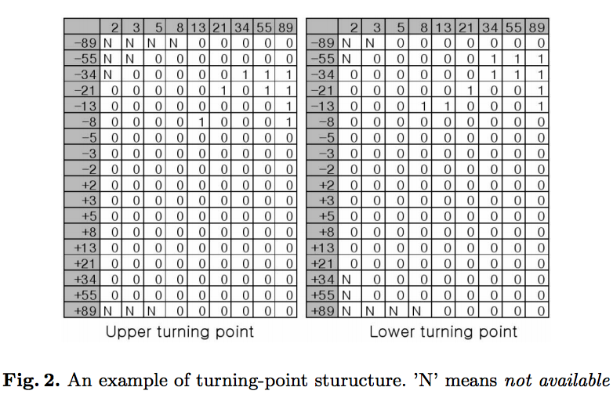
Proposed Framework and Algorithm
- States, Actions, and Rewards
We adopt a binary matrix, the turning-point structure, summarizing the long-term dependencies based on both upper and lower turning points of 5-day moving averages. (a data structure for summarizing the historic information of price changes for a long period. )
The columns represent the displacement of the day of a turning point from the reference day.
The rows represent the displacement of the price of a turning point from the reference day.
The value ‘N’ means that this slot can not be hit since the price of stocks in KOSPI never reaches that entry.

Slide 10
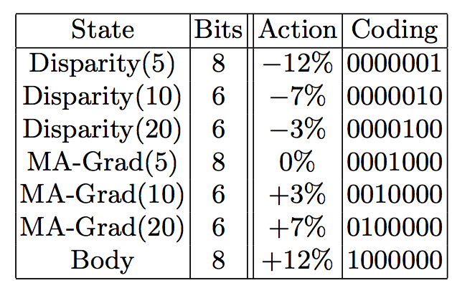
Proposed Framework and Algorithm
- States, Actions, and Rewards
We adopt a binary matrix, the turning-point structure, summarizing the long-term dependencies based on both upper and lower turning points of 5-day moving averages.
The total number of bits required to represent both matrices for the turning points is 305 with ‘N’ entries eliminated.
In addition to these temporal structures, the buy signal agent shares the short-term technical indicators shown in Table 2, with the ordering agents. After all, the state of the buy signal agent consists of 353 binary bits.

Slide 11
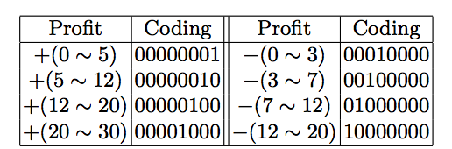
Proposed Framework and Algorithm
- States, Actions, and Rewards
We adopt a binary matrix, the turning-point structure, summarizing the long-term dependencies based on both upper and lower turning points of 5-day moving averages.
The sell signal agent has a few bits more, which represent the current profit rate during a holding period of a stock as shown in Table 1.
We confine arbitrarily the profit range as +30% ∼ −20%.
while holding the stock, if its profit rises above +30% or falls down below −20%, the sell signal agent is compelled to sell the stock forcedly.

Slide 12
Proposed Framework and Algorithm
- States, Actions, and Rewards
The signal agents can take only two kinds of actions.
The buy signal agent takes NOT-BUY or BUY and the sell signal agent takes HOLD or SELL.
calculation of reward is as follows.
The buy signal agent is given zero reward while it takes NOT-BUY.
If it takes BUY the calculation of its reward is postponed until the sell order agent sells the stock.
The rate of daily changes of stock prices are given while the sell signal agent takes HOLD.
But when it takes SELL, zero reward is given.
When the sell price is determined by the sell order agent, the buy signal agent receives the profit rate, considering the transaction cost, as the reward.

Slide 13
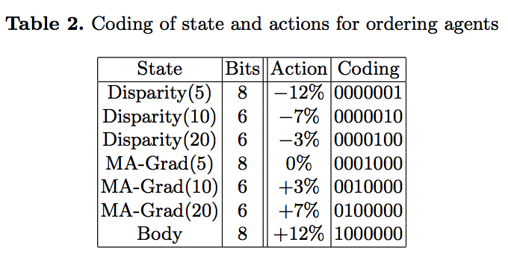
Proposed Framework and Algorithm
- States, Actions, and Rewards
Ordering agents share the state and possible actions shown in Table 2.
For a given state, the buy order agent tries to make an optimal bid, that is, the bid at lowest price in the range of stock price changes of the next day.
When trading stocks with very high volatility, the buy price may significantly affect to the final profit of the trade.

Slide 14
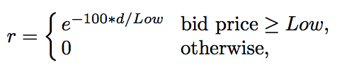
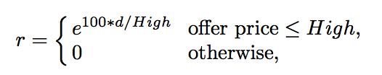
Proposed Framework and Algorithm
- States, Actions, and Rewards
The reward of the buy order agent is defined as:
where d = bid price − Low
If d is 0, the agent receives the maximal reward.
Similarly the reward of the sell order agent is defined using High:
where d = bid price − Low

Slide 15
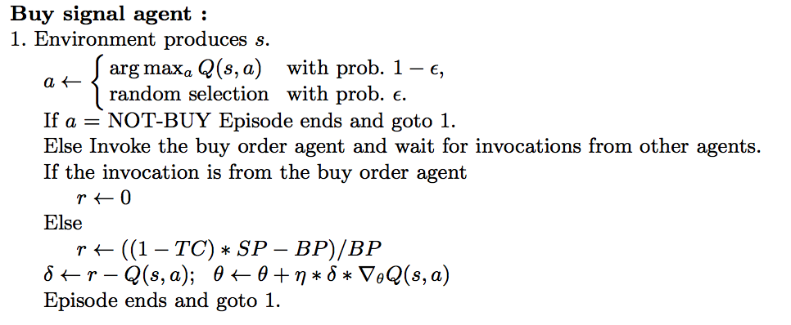
Proposed Framework and Algorithm
- Learning Algorithm
An episode starts with a stock at a certain day randomly chosen by the environment. If the buy signal agent takes NOT-BUY as a response to the state of the given stock, the episode ends and a new episode starts. But if the buy signal agent takes BUY, it invokes the buy order agent.

Slide 16
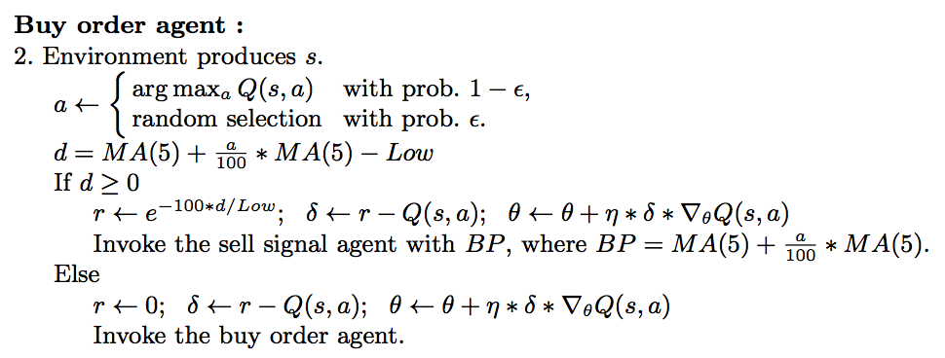
Proposed Framework and Algorithm
- Learning Algorithm
The buy order agent refers the state of the stock at the same day and determines the bid price. If the stock can not be purchased, the episode ends and invokes the buy signal agent with 0 as the reward.

Slide 17
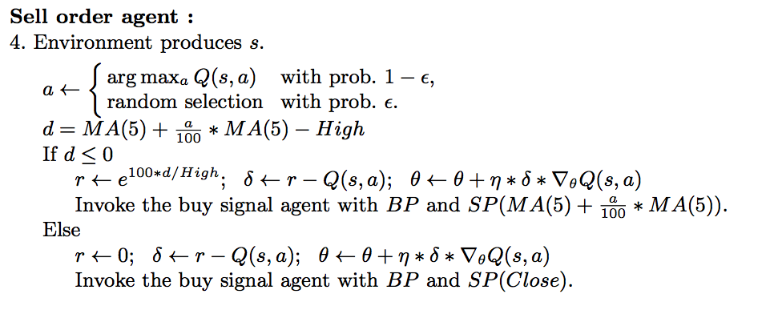
Proposed Framework and Algorithm
- Learning Algorithm
If the sell order agent fails to sell the stock with its offer price, it sells the stock at close, the last traded price of the day.

Slide 18
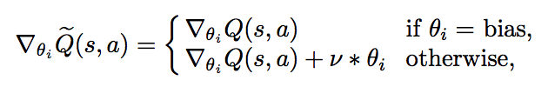
Proposed Framework and Algorithm
- Learning Algorithm
In this paper, to make the problem simple, we introduce the regularized gradient descent as:
where ν is the constant that controls the degree of weight decay.

Slide 19
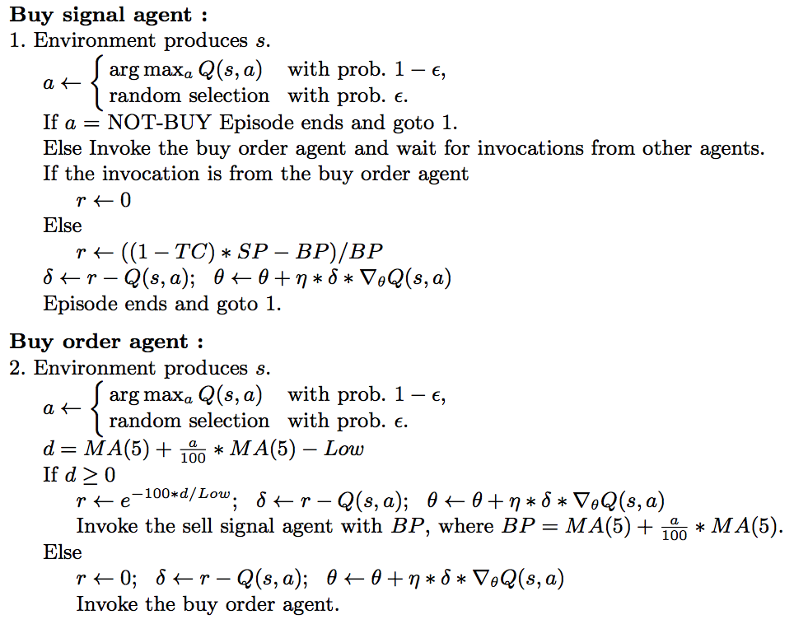
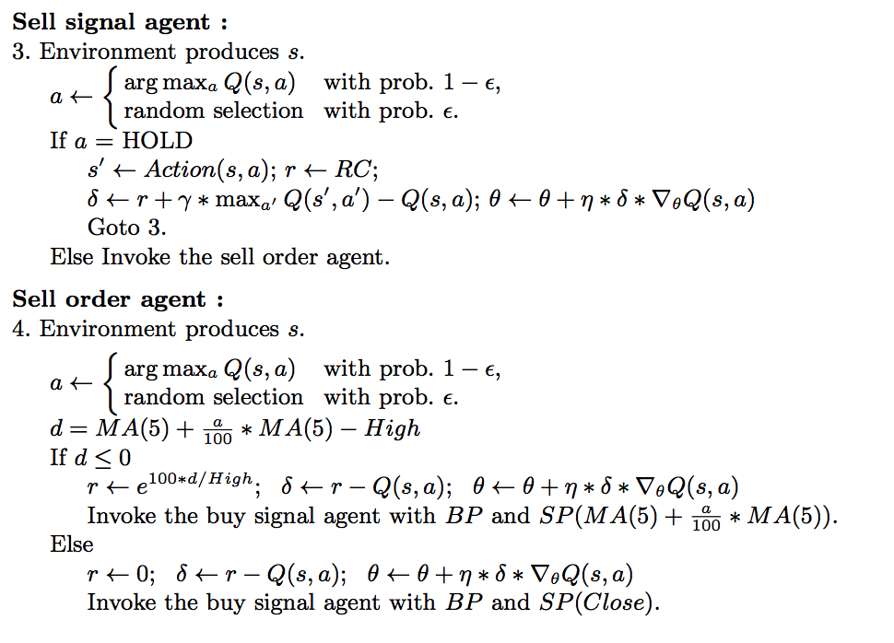
Proposed Framework and Algorithm
- Learning Algorithm

Slide 20
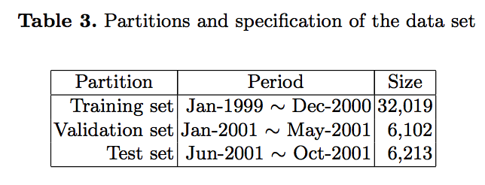
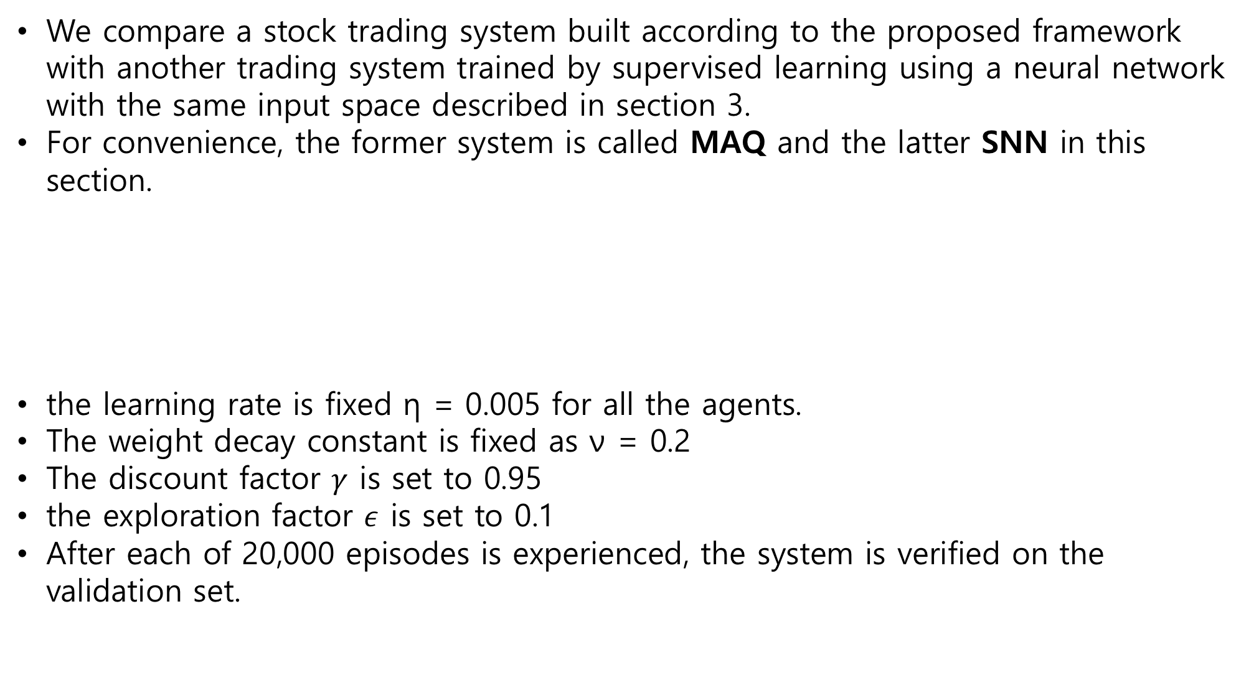
Experiment
We compare a stock trading system built according to the proposed framework with another trading system trained by supervised learning using a neural network with the same input space described in section 3.
For convenience, the former system is called MAQ and the latter SNN in this section.
the learning rate is fixed η = 0.005 for all the agents.
The weight decay constant is fixed as ν = 0.2
The discount factor $γ$ is set to 0.95
the exploration factor $ε$ is set to 0.1
After each of 20,000 episodes is experienced, the system is verified on the validation set.

Slide 21
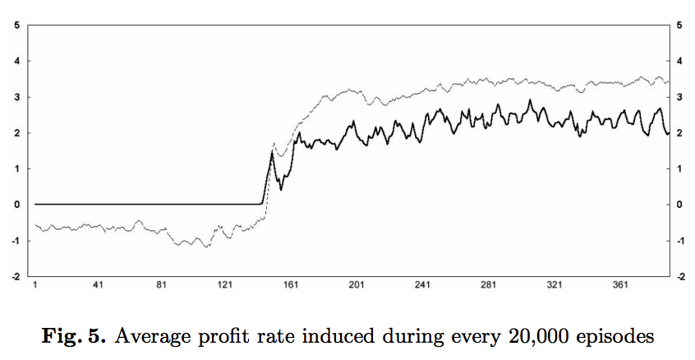
Experiment
Fig. 5 shows the tendency of the training performance of MAQ.

Slide 22
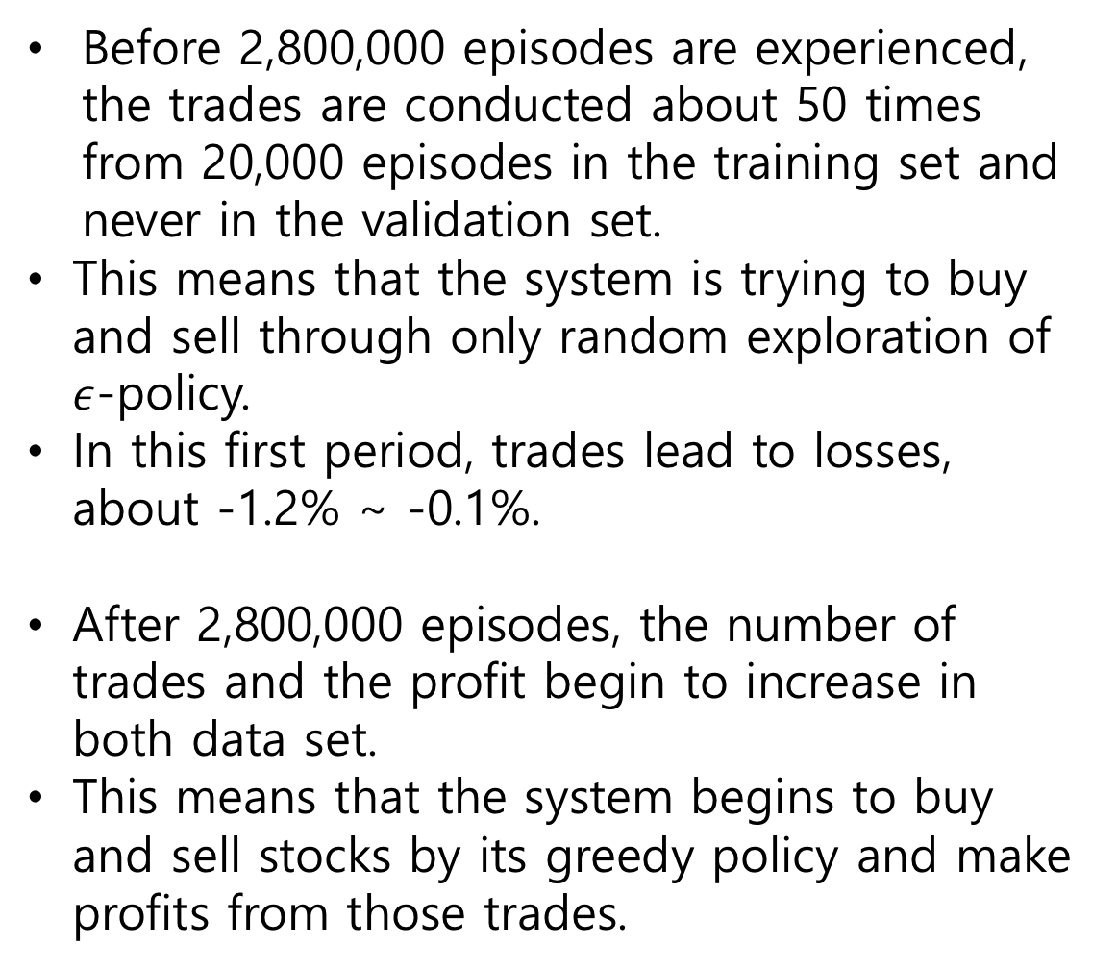
Experiment
Before 2,800,000 episodes are experienced, the trades are conducted about 50 times from 20,000 episodes in the training set and never in the validation set.
This means that the system is trying to buy and sell through only random exploration of $ε$-policy.
In this first period, trades lead to losses, about -1.2% ∼ -0.1%.
After 2,800,000 episodes, the number of trades and the profit begin to increase in both data set.
This means that the system begins to buy and sell stocks by its greedy policy and make profits from those trades.

Slide 23
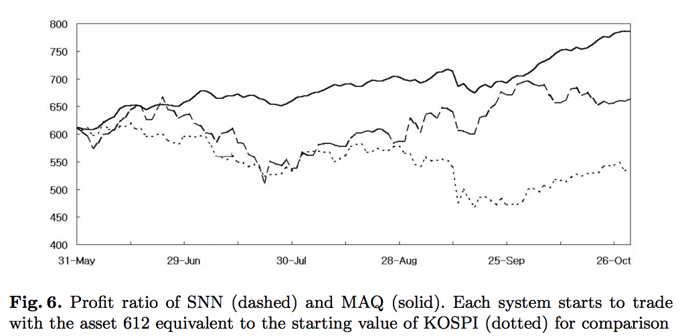
Experiment
Fig. 6 shows the performance of both SNN and MAQ on the test set.
KOSPI is 612 point on the starting day of the test period.
On the whole, it can be said that MAQ outperforms both the market index and SNN.
At the end of the test period, the asset of MAQ increases 28.26% to 785 while that of SNN increases 8.49% to 664.

Slide 24
Experiment
In view of risk management, MAQ is also superior to SNN.
There are two shocks in KOSPI during the test period.
One is the internal shock between June to July, that is, the market is in a normal bear trend. The profit of SNN is severely degraded from this shock but MAQ endures the shock with a relatively small loss.
The other is an external shock, the tragedy of September 11, 2001.
Both systems lead to severe losses for this short period.
But the profit of MAQ is increased steadily while that of SNN somewhat fluctuates.

Slide 25
Conclusion
there are several additional realistic considerations to be incorporated in a stock trading system. These include the number of portfolios, the distribution of the asset to each portfolio, and adaptation of the trend of the stock market.

